Slide 1
Node

Slide 2
Front End Framework Architecture
Node js
( Web Server )
IDE
Visual Studio
developer
VUE
React
SOURCE
result
Anguler
Support Tool
Web pack
(compress & compile)
Front End F/W 다운로드 수 통계 자료
https://2017.stateofjs.com/2017/front-end/results/
https://2018.stateofjs.com/data-layer/overview/

Slide 3
Adventages of Node
V8 Engene Based Structure
javascript
powerful language
easy Learning curve
Socket IO
all platform powerful push function
Single Thread Based Event Loop

Slide 4
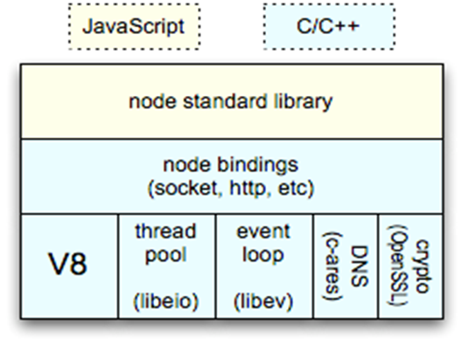
Node Core Module Architecture
Async / Non blocking IO
Single Thread Model
Thread pool
Event Loop

Slide 5
Node Syntax Example
npm install --save-dev webpack webpack-cli
npm install –g webpack webpack-cli
npm install --save-dev @babel/core @babel/preset-env
npm install --save-dev react react-dom @babel/preset-react
npm install -g babel-preset-react
npm install --save-dev html-webpack-plugin html-loader
npm install --g html-webpack-plugin html-loader
npm install vue --save npm install vue-loader vue-template-compiler -D

